Slide 1
Device Support Interfaces in EPICS base
Kay Kasemir
Material copied from APS
“Getting Started with EPICS Lecture Series: Writing Device Support”, Eric Norum, November 16, 2004
July 2026

Slide 2
EPICS Nomenclature
IOC
Hardware
Record
Record:
Database processing block
  AI record: ‘read’ a number,
  AO record: ‘write’ a number,
  STRINGOUT: ‘write’ a string, …
Device Support
Record
Device Support
Driver
Device Support: Links Record to Hardware, maybe via Driver
  AI device support: read(aiRecord *ai)
  AO device support: write(aoRecord *ao)
Driver: Code that talks to hardware
  Ideally available as C(++) source code
  Could be in binary form, from hardware vendor
  May be totally unaware of EPICS

Slide 3
Fundamentally Easy
Assume existing ‘driver’ with XyzDriver_read()
Implement ‘device support’ for AI:
  // Called by AI record when processed
  long ai_read_xyz(aiRecord *ai)
  {
  // Call driver to get number
  // into record’s raw value field
  ai->rval = XyzDriver_read();
  // Done, no error
  return 0;
  }
Some boilerplate to inform EPICS that AI record can now use DTYP=“XYZ”
which should call ai_read_xyz()

Slide 4
Of course, there’s more
Set AI record’s RVAL and let the record convert to EGU,
or set the record’s VAL?
How to decide what to read exactly?
record(ai, “MyXYZTest”)
{
field(DTYP, “XYZ”)
field(INP, “#C0 S2 @unipolar”)
…
}
Handle errors?
What if instead of
  Record gets scanned → read from device
… I want
  Device changes → Process the record!

Slide 5

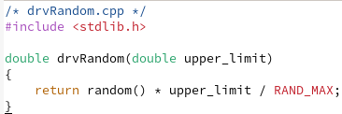
Example: Assume a simple Driver
/ics/examples/20_devsup/devsupApp/src

Slide 6
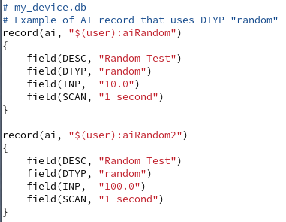
Example Database
Idea:
Random number 0 .. 10
Random number 0 .. 100
/ics/examples/20_devsup/devsupApp/Db

Slide 7
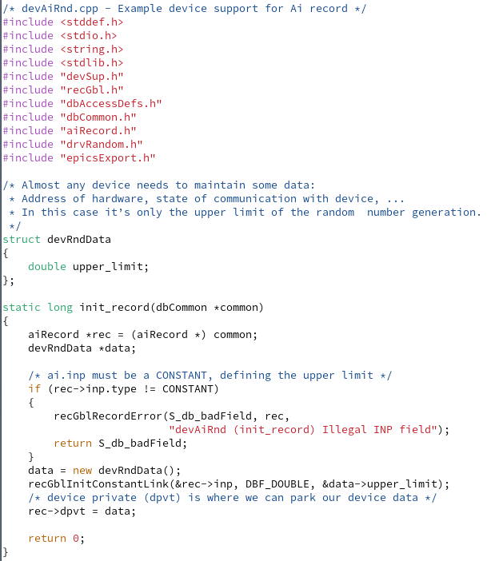
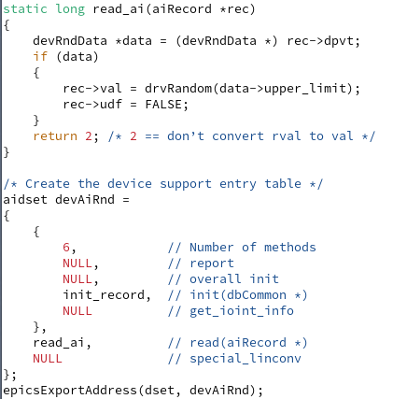
Device Support for AI Record
/ics/examples/20_devsup/devsupApp/src

Slide 8
DBD File
“my_device.dbd”:
device(ai, CONSTANT, devAiRnd, ”random")
/ics/examples/20_devsup/devsupApp/src

Slide 9
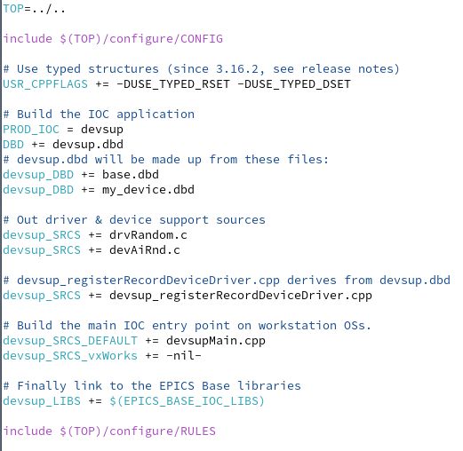
Makefile
From
makeBaseApp.pl –t ioc
then adding our code
/ics/examples/20_devsup/devsupApp/src

Slide 10
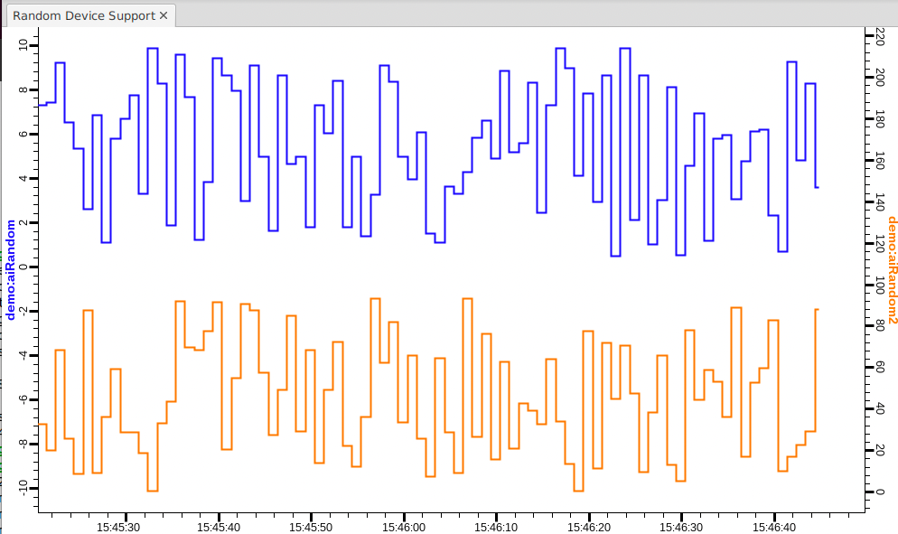
IOC
cd /ics/examples/iocBoot/ioc_deviceSupport
./st.cmd

Slide 11
“Device Private”, DPVT
Used to store whatever you need to store
  Information fetched
  at initialization,
  needed for read/write
  Pointers to driver structures
Previous example: ‘devRndData’

Slide 12
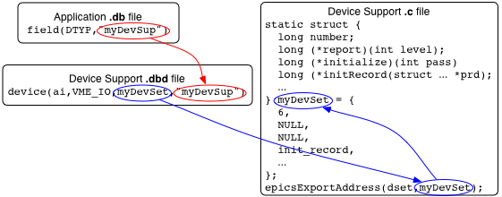
Recapitulate: From DTYP to read()

Slide 13
The .dbd file entry
The IOC discovers device support from entries in .dbd files
  device(recType, addrType, dsetName, ”dtypeName”)
recType is ai ao …
addrType is one of
  CONSTANT AB_IO BITBUS_IO CAMAC_IO GPIB_IO
  INST_IO RF_IO VME_IO VXI_IO
  CONSTANT: A number
  INST_IO: String
dsetName is the name of the Device Support Entry Table (DSET)
  By convention name indicates record and hardware type:
  device(ai, GPIB_IO, devAidg535, "dg535")
  device(bi, VME_IO, devBiXy240, "XYCOM-240")
Notes:
This is where the actual control and data acquisition occurs.

Slide 14
Read-worthy sections of EPICS App. Devel. Guide
OS-independent routines for register access, threads, semaphore, interrupts, …
Support for SCAN=“I/O Intr”, DSET getIoIntInfo()
Support for conversions, DSET specialLinconv()

Slide 15
More Examples
20c Custom Device Support VME.txt
Register-based hardware can be easy
20d Device Support_Problematic.pdf
What is wrong?
Compare Stream Device
  out “*01X01”;
  in “%f”;

Slide 16
What’s problematic in the 2nd example?
Record with INP=“10.1.2.3” will connect to that IP, send “*01X01” and read number into record’s VAL
Could split “device” and “driver”
Can’t have records with different INP
  Use rec->dpvt instead of one global monitor_ip
Connects/disconnects each time. Slow!!
  Should keep connection open
Blocks while reading
  Driver must connect, read, … in separate thread
Exit() on connection error
  Set rec->sevr and stat to INVALID, READ
Not checking format of received value

Slide 17
Summary: Device Support is
Glue between records and hardware (“driver”)
Fundamentally easy:
  Maybe “init()”
  “read()” or “write()”
  Boilerplate to register: DSET, *.dbd “device(…)”
A great opportunity to shoot yourself in the foot
Consider building on StreamDevice or Asyn

